Slide 1
Organizational Architecture as a Source of
Sustainable Strategic Competitive Advantage (SSCA)
Jim Clawson
Darden Graduate School of Business
University of Virginia
Notes:
_________________________________________________________
_________________________________________________________
_________________________________________________________
_________________________________________________________
_________________________________________________________
_________________________________________________________
_________________________________________________________
_________________________________________________________
_________________________________________________________
_________________________________________________________
_________________________________________________________
_________________________________________________________
_________________________________________________________

Slide 2
Organizational Architecture
a Key Element in our Leadership Model
1. Who are
you?
3. Can you
“sell” your story?
ENVIRONMENT
2. What’s
Your
“story?”
L
RESULTS
FINANCIAL$
CUSTOMER
SATISFACTION
CAPABILITIES
HC+SC+OC
E
S
O
4. Does your
organization
help or hinder?
5. Can you
lead change
to keep up?

Slide 3
Organizational Architecture is an SSCA because it . . .
Adds superior value to customers
Is hard to imitate
Enhances flexibility.
George Day’s (Wharton) definition of Competitive Advantage
Notes:
_________________________________________________________
_________________________________________________________
_________________________________________________________
_________________________________________________________
_________________________________________________________
_________________________________________________________
_________________________________________________________
_________________________________________________________
_________________________________________________________
_________________________________________________________
_________________________________________________________
_________________________________________________________
_________________________________________________________

Slide 4
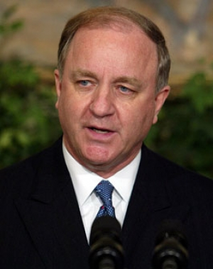
Randall Tobias, former CEO Eli Lilly
Put the Moose on the Table, Interview with David Creelman
“It has always been my view that if a company can find a way to attract and retain better people than their competitors, if they can get those people organized in such a way that everyone is going in the same direction, if they can create a culture that enables all those people to work together effectively, then you will beat your competitors every time.”

Slide 5
Designs Majorly Affect Results
DESIGN
DECISIONS
Culture
RESULTS
Profit
CVP
CC’s
HC+SC+OC
Background
Factors
Leadership
Philosophy
Notes:
_________________________________________________________
_________________________________________________________
_________________________________________________________
_________________________________________________________
_________________________________________________________
_________________________________________________________
_________________________________________________________
_________________________________________________________
_________________________________________________________
_________________________________________________________
_________________________________________________________
_________________________________________________________
_________________________________________________________

Slide 6
“A man went into buy a suit ….”
MORAL: Don’t force people into jobs they don’t fit.

Slide 7
Design for Choice or Obligation?
Energy?
Commitment?
Productivity?
Innovation?
Engagement?
CHOICE
OBLIGATION

Slide 8
Common HR related
DESIGN
DECISIONS
Rewards
Work
Design
Appraisal
Selection
Outplacement
Learning
Socialization
Notes:
_________________________________________________________
_________________________________________________________
_________________________________________________________
_________________________________________________________
_________________________________________________________
_________________________________________________________
_________________________________________________________
_________________________________________________________
_________________________________________________________
_________________________________________________________
_________________________________________________________
_________________________________________________________
_________________________________________________________

Slide 9
System Mis-alignment drains
Organizational Energy
ORGANIZATIONAL
DESIGN
DECISIONS
Leadership
Philosophy
REWARD SYSTEMS
HIRING
WORK
DESIGN
APPRAISAL
Outplacement
LEARNING SYSTEMS
Notes:
_________________________________________________________
_________________________________________________________
_________________________________________________________
_________________________________________________________
_________________________________________________________
_________________________________________________________
_________________________________________________________
_________________________________________________________
_________________________________________________________
_________________________________________________________
_________________________________________________________
_________________________________________________________
_________________________________________________________

Slide 10
System Alignment is Key to
Organizational Energy
ORGANIZATIONAL
DESIGN
DECISIONS
Leadership
Philosophy
REWARD SYSTEMS
HIRING
WORK
DESIGN
APPRAISAL
Outplacement
LEARNING SYSTEMS
Notes:
_________________________________________________________
_________________________________________________________
_________________________________________________________
_________________________________________________________
_________________________________________________________
_________________________________________________________
_________________________________________________________
_________________________________________________________
_________________________________________________________
_________________________________________________________
_________________________________________________________
_________________________________________________________
_________________________________________________________

Slide 11
Intangible Capital Pools
Human Capital: the sum of what all employees can do.
Social Capital: the incremental value added or lost by how people work together.
Organizational Capital: the incremental value added or lost by your organization and systems.

Slide 12
Is your “Organizational Capital” positive or negative?
Does your organization help or hinder getting positive results?
RESULTS
Profit
CVP
CC’s
HC+SC+OC

Slide 13
Organizational Architecture depends on your model of business
… (The Living Company, Arie deGeus)
Economic Model of Business
  To make money
  People are “assets” or “capital”
  Efficiency squeeze model
Societal Purpose Model of Business
  To add value to society
  People as people
  Value growth model

Slide 14

Organizational Culture is the result of putting people in your design …
Organi-
zational
Culture
Rewards
+
=
Selection
Work
Design
Appraisal
Outplacement
Socialization
Learning

Slide 15


and…
“Culture eats strategy for breakfast.”
Sign hanging in the Ford Motor Company’s Organizational Change War Room
“Culture isn’t just one aspect of the game—it is the game.”
Louis V. Gerstner Jr., former CEO of IBM, Business Week, 2/12/07, p. 73)

Slide 16
Mexico City Pollution Problem
How can we reduce pollution in this city of 20,000,000 in a bowl of mountains at 7,000 feet altitude?
Why didn’t they “buy in?”

Slide 17
BUY-IN
Passion (This is #1 in my life.)
Engagement (I want to do it.)
Agreement (I will do it.)
Compliance (I’m looking for loopholes.)
Apathy (I don’t care.)
Passive Resistance (I make mistakes.)
Active Resistance (I’ll fight you.)

Slide 18
therefore
Leadership is about …
Managing energy,
first in yourself and then in others.

Slide 19
Design for Choice or Obligation?
Energy?
Commitment?
Productivity?
Innovation?
Engagement?
CHOICE
OBLIGATION

Slide 20

The obligatory commute …

Slide 21
Energy Drains
Economic Business Model (make others rich)
Problem Solving Focus (react to problems)
Oscillating Change (back and forth)
Mismatched or Vague Purpose (confusion)
Unaligned Systems (HRM and others)
Weak Leadership (no charter)
Goals over Experience/Feel (do it or else)

Slide 22
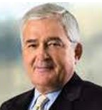
The world craves clarity …
And most “strategic” conversations are fuzzy, misleading, and confusing…
“Lack of focus is the most common cause of corporate mediocrity.”
Lou Gerstner, Who Says Elephants Can’t Dance?

Slide 23
Clarifying your “strategic story” with Charters
LEADERSHIP
4. Strategy
1. Mission
2. Vision
5. ST OP Goals
3. Values
1. Mission Statement
2. Vision Statement
3. Values Statement
4. Strategy
5. Operating Goals and Milestones
6. Leadership

Slide 24
CHARTERS
1. Mission Statement: | A definition of what we do. (very short)
2. Vision Statement: | A descriptive picture of what we can and want to become in the future. (detailed)
3. Values Statement: | A list of the principles that define what we stand for that shapes our style. (short)
4. Strategy Statement | A broad outline of how we are going to go about our mission and move toward our vision. (longest: financial, marketing, etc.)
5. Short Term Measures: | Short-term targets and hurdles by which we measure and review our interim progress. (be careful to get the right ones)

Slide 25
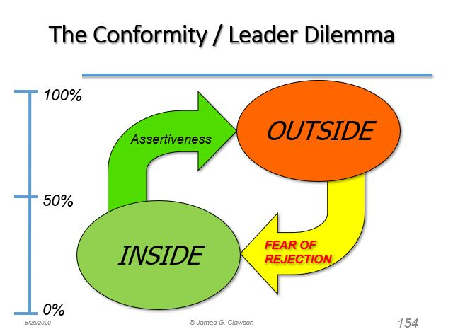
6. Who is making these decisions?

Slide 26
Charters can and should be developed at several levels
SOCIETAL
CORPORATE
COMPANY
WORK GROUP
INDIVIDUAL
Can you bring clarity to those you lead?

Slide 27
Common HR related
DESIGN
DECISIONS
Rewards
Work
Design
Appraisal
Selection
Outplacement
Learning
Socialization
Notes:
_________________________________________________________
_________________________________________________________
_________________________________________________________
_________________________________________________________
_________________________________________________________
_________________________________________________________
_________________________________________________________
_________________________________________________________
_________________________________________________________
_________________________________________________________
_________________________________________________________
_________________________________________________________
_________________________________________________________

Slide 28
Selection
Recruit where?
Hire for Attitude and Energy as much as skill?
Hire for learning orientation?
Hire for cultural fit?
Recognizes Career Concepts? (Linear, Steady State Experts, Spirals, Transitories)
Fits strategic direction?
What kind of organization are you trying to create?

Slide 29
Socialization/On-boarding
Orient new hires to company culture?
Orient new hires to company communications?
What’s your “on-boarding” process?
What kind of bond between employee and organization are you trying to create?

Slide 30
Work Design

Slide 31
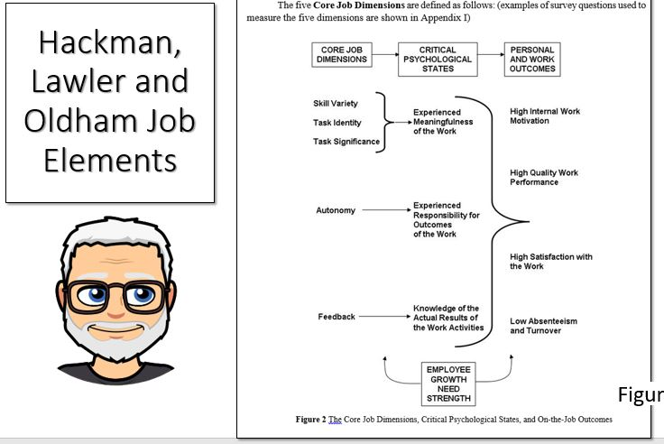

Slide 32
Does Your Work Design
Encourage autonomy?
Encourage completion of tasks?
Encourage variety?
Include immediate feedback?
Focuse on significant work?
What kind of work are you trying to create?

Slide 33
BTW, empowerment is not binary.
What do you allow employees to do?
Identify issues
Analyze issues
Generate Options
Propose action
Select action
Implement action
Evaluate action
Less
What’s the Creative Alternative?
More
Notes:
_________________________________________________________
_________________________________________________________
_________________________________________________________
_________________________________________________________
_________________________________________________________
_________________________________________________________
_________________________________________________________
_________________________________________________________
_________________________________________________________
_________________________________________________________
_________________________________________________________
_________________________________________________________
_________________________________________________________

Slide 34
Performance Appraisal
No one likes to give them
No one likes to get them
Tend to be inaccurate
Soak up enormous amounts of energy
  so SAS Institute’s Jim Goodnight decided not to do them
Perceived Fairness?
Transparent?
Merit-based? Skill based?
Absolute scales or Relative scales?
What kind of work force are you trying to create?

Slide 35
Reward Systems
Based on skill, learning, history, tenure, productivity, innovation, ???
Absolute or Relative? Forced curve?
Impact on energy?
Transparency?
Recognizes different Career Concepts?

Slide 36
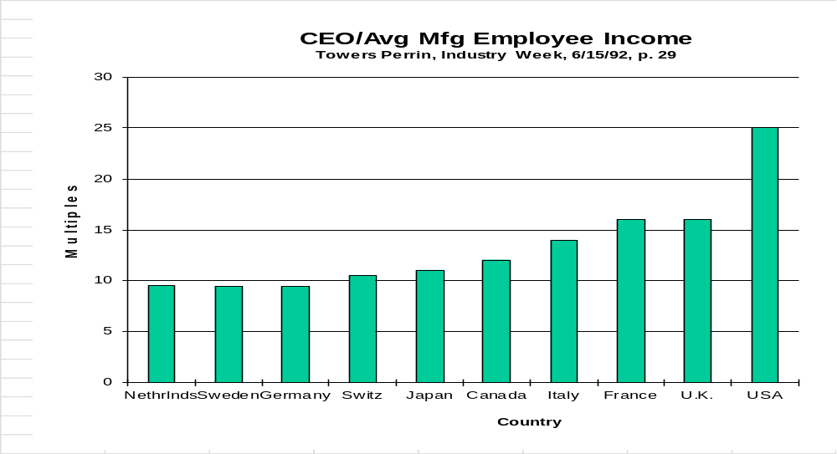
Executive Pay Multiples (1992)

Slide 37
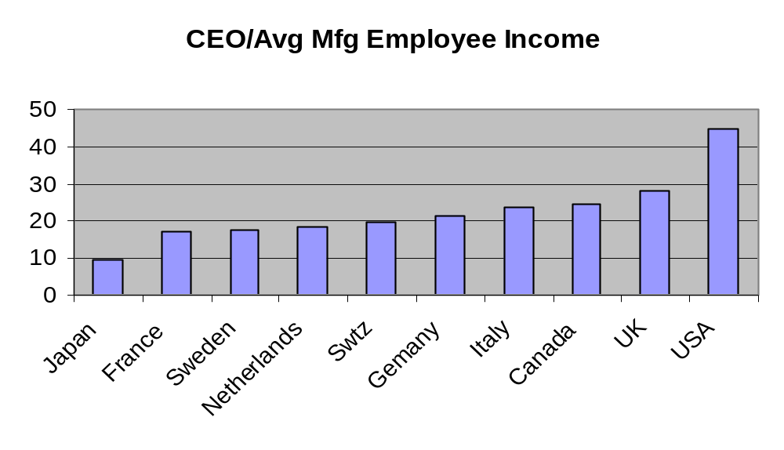
Executive Pay Multiples (2003)
Towers Perrin, Worldwide Total Remuneration 2003-04

Slide 38
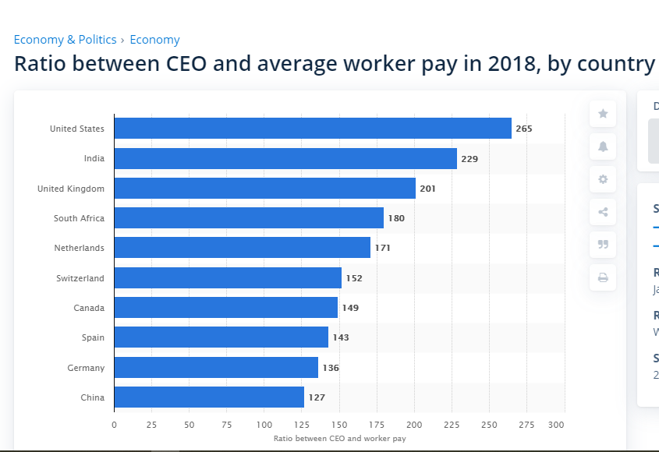

Slide 39

“The more significant problem is precisely that the effects of rewards do last, but these effects are the opposite of what we were hoping to produce.
What rewards do, and what they do with devastating effectiveness, is smother people’s enthusiasm for activities they might otherwise enjoy.”
Alfie Kohn, Punished by Rewards, p. 74

Slide 40
Outplacement
Used as solution for management weakness?
Facilitated?
“Puddle” or “River” organization (deGeus)

Slide 41
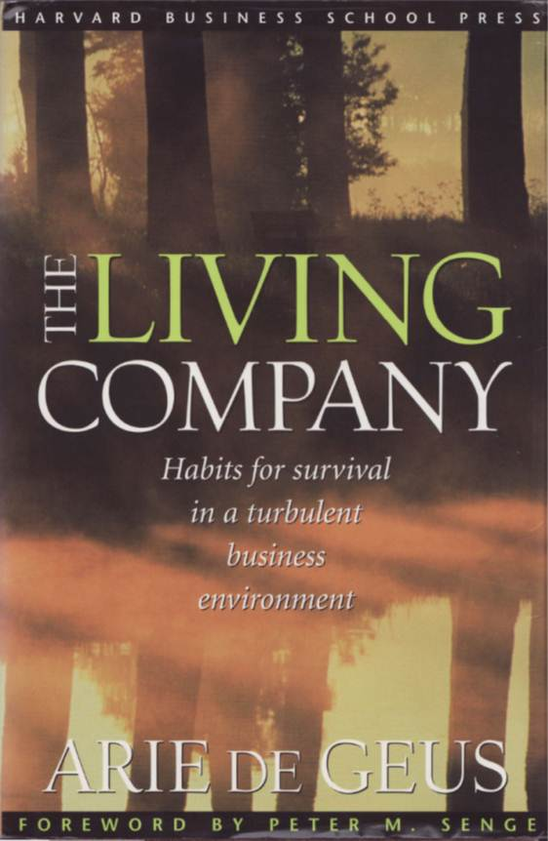
The Importance of Organizational Learning
The only real source of competitive advantage may be
the capacity to learn.
Arie de Geus, The Living Company
Notes:
_________________________________________________________
_________________________________________________________
_________________________________________________________
_________________________________________________________
_________________________________________________________
_________________________________________________________
_________________________________________________________
_________________________________________________________
_________________________________________________________
_________________________________________________________
_________________________________________________________
_________________________________________________________
_________________________________________________________

Slide 42
So is Learning …
Part of your management culture?
Part of your company culture? (WD-40)
Offered for everyone?
Part of the different Career Concepts?

Slide 43
If Leadership is
Managing Energy …
Does how you feel affect your performance?
How do you want to feel?
How engaged are you at work?
How engaged on average are your colleagues?
How do you manage energy?
How are your competitors managing energy?

Slide 44
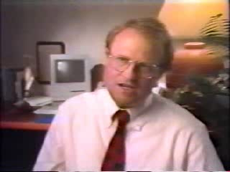
The Link between
Feel and Performance

Slide 45
High Energy Organizations
Pike Place Fish Market (12)
BAE Aberdeen Plant (100)
SAS Institute (3,500)
Southwest Airlines (35,000)

Slide 46
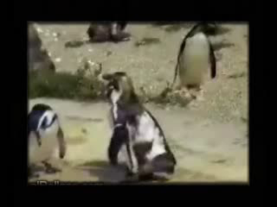
High Energy Employees

Slide 47

Too Much?

Slide 48
Jeff Pfeffer’s Seven Practices of Successful Organizations
Selective Hiring
Employment Security
Self-managed teams and decentralized decision-making
Minimizing status differentials
Extensive Information Sharing
High rewards based on organizational performance
Extensive training
Jeff Pfeffer, The Human Equation, HBS Press, Boston, 1998.
Notes:
_________________________________________________________
_________________________________________________________
_________________________________________________________
_________________________________________________________
_________________________________________________________
_________________________________________________________
_________________________________________________________
_________________________________________________________
_________________________________________________________
_________________________________________________________
_________________________________________________________
_________________________________________________________
_________________________________________________________

Slide 49
What does this all mean to you?
Do you have a personal & team charter?
Do you have a creative vision?
Are you designing for energy or heads/assets?
Are your HR systems/processes aligned?
Do you manage your culture?
Are you living inside-out or outside-in?
Is your Organizational Architecture a source of competitive advantage or disadvantage?

Slide 50
The Research on Organizational Architecture as a Source of Strategic Competitive Advantage

Slide 51
Researchers on HRM SSCA
Noel Tichy (Managing Strategic Change)
David Ulrich (The HR Value Proposition)
Jeffrey Pfeffer (Competitive Advantage Through People)
Ed Lawler (Talent: Making People Your Competitive Advantage)
Notes:
_________________________________________________________
_________________________________________________________
_________________________________________________________
_________________________________________________________
_________________________________________________________
_________________________________________________________
_________________________________________________________
_________________________________________________________
_________________________________________________________
_________________________________________________________
_________________________________________________________
_________________________________________________________
_________________________________________________________

Slide 52
How is (your organization) designed in these key areas? (Tichy)
Reward
Work
Design
Appraisal
Selection
Outplacement
Learning
Notes:
_________________________________________________________
_________________________________________________________
_________________________________________________________
_________________________________________________________
_________________________________________________________
_________________________________________________________
_________________________________________________________
_________________________________________________________
_________________________________________________________
_________________________________________________________
_________________________________________________________
_________________________________________________________
_________________________________________________________

Slide 53
Jeff Pfeffer (Stanford) Competitive Advantage
Through People
Selectivity in Recruiting
Jeffrey Pfeffer, Producing sustainable competitive advantage through the effective management of people, Competitive Advantage through People, HBS Press, 1994, (AME, 1995, V. 9. N. 1
Notes:
_________________________________________________________
_________________________________________________________
_________________________________________________________
_________________________________________________________
_________________________________________________________
_________________________________________________________
_________________________________________________________
_________________________________________________________
_________________________________________________________
_________________________________________________________
_________________________________________________________
_________________________________________________________
_________________________________________________________

Slide 54
SELECTION CRITERIA
Problem solvers
Team players
Accept leadership responsibility
Effective communicators
Active learners
Notes:
_________________________________________________________
_________________________________________________________
_________________________________________________________
_________________________________________________________
_________________________________________________________
_________________________________________________________
_________________________________________________________
_________________________________________________________
_________________________________________________________
_________________________________________________________
_________________________________________________________
_________________________________________________________
_________________________________________________________

Slide 55
Competitive Advantage
Through People
Selectivity in Recruiting
Employment Security
High Wages
Incentive Pay
Employee Ownership
Jeffrey Pfeffer, Producing sustainable competitive advantage through the effective management of people, Competitive Advantage through People, HBS Press, 1994, (AME, 1995, V. 9. N. 1
Notes:
_________________________________________________________
_________________________________________________________
_________________________________________________________
_________________________________________________________
_________________________________________________________
_________________________________________________________
_________________________________________________________
_________________________________________________________
_________________________________________________________
_________________________________________________________
_________________________________________________________
_________________________________________________________
_________________________________________________________

Slide 56
Competitive Advantage
Through People
Information Sharing
Participation and Empowerment
Notes:
_________________________________________________________
_________________________________________________________
_________________________________________________________
_________________________________________________________
_________________________________________________________
_________________________________________________________
_________________________________________________________
_________________________________________________________
_________________________________________________________
_________________________________________________________
_________________________________________________________
_________________________________________________________
_________________________________________________________

Slide 57
Competitive Advantage
Through People
Self-Managed Teams
Training and Skill Development
Cross Utilization and Training
Symbolic Egalitarianism
Wage Compression
Notes:
_________________________________________________________
_________________________________________________________
_________________________________________________________
_________________________________________________________
_________________________________________________________
_________________________________________________________
_________________________________________________________
_________________________________________________________
_________________________________________________________
_________________________________________________________
_________________________________________________________
_________________________________________________________
_________________________________________________________

Slide 58
Competitive Advantage
Through People
Promotion from Within
Notes:
_________________________________________________________
_________________________________________________________
_________________________________________________________
_________________________________________________________
_________________________________________________________
_________________________________________________________
_________________________________________________________
_________________________________________________________
_________________________________________________________
_________________________________________________________
_________________________________________________________
_________________________________________________________
_________________________________________________________

Slide 59
Dumb Things
Smart Organizations Do
Follow the crowd doing what they do.
Pressure careers to make the numbers and be mobile.
Rely too much on leaders making delegation difficult.
Reward financials and not development
Notes:
_________________________________________________________
_________________________________________________________
_________________________________________________________
_________________________________________________________
_________________________________________________________
_________________________________________________________
_________________________________________________________
_________________________________________________________
_________________________________________________________
_________________________________________________________
_________________________________________________________
_________________________________________________________
_________________________________________________________

Slide 60
Dumb Things
Smart Organizations Do (2)
Excessive focus on cost
Focus training on finance at the expense of HR development
Excessive focus on “knowing” rather than “learning.”
Focus on capital markets at the expense of other stakeholders.
Notes:
_________________________________________________________
_________________________________________________________
_________________________________________________________
_________________________________________________________
_________________________________________________________
_________________________________________________________
_________________________________________________________
_________________________________________________________
_________________________________________________________
_________________________________________________________
_________________________________________________________
_________________________________________________________
_________________________________________________________

Slide 61
Learning Organizations
The organization learns from experiences and doesn’t repeat mistakes.
When someone leaves, his or her knowledge remains.
When a team completes a task, it distills and documents what it has learned.
Notes:
_________________________________________________________
_________________________________________________________
_________________________________________________________
_________________________________________________________
_________________________________________________________
_________________________________________________________
_________________________________________________________
_________________________________________________________
_________________________________________________________
_________________________________________________________
_________________________________________________________
_________________________________________________________
_________________________________________________________

Slide 62
Learning Organizations (2)
Knowledge generated in the organization is consolidated and distributed to all.
The organization systematically assesses future learning needs and plans to meet them.
The organization facilitates experimentation as a way to learn.
The organization learns from other organizations how to learn.
Notes:
_________________________________________________________
_________________________________________________________
_________________________________________________________
_________________________________________________________
_________________________________________________________
_________________________________________________________
_________________________________________________________
_________________________________________________________
_________________________________________________________
_________________________________________________________
_________________________________________________________
_________________________________________________________
_________________________________________________________

Slide 63
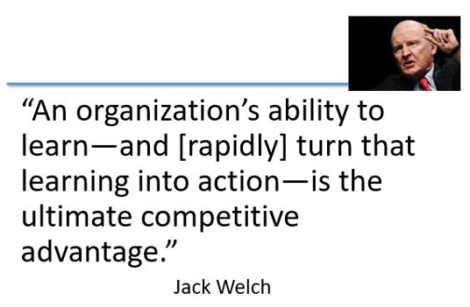

Slide 64

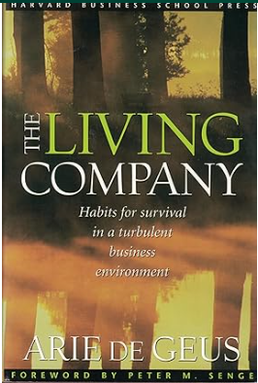

Slide 65
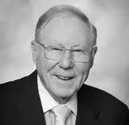
Choice Theory
If you’re not getting what you want, what are you going to change?
William Glasser
It’s crazy to expect different results while you continue doing the same thing.
Albert Einstein
Notes:
_________________________________________________________
_________________________________________________________
_________________________________________________________
_________________________________________________________
_________________________________________________________
_________________________________________________________
_________________________________________________________
_________________________________________________________
_________________________________________________________
_________________________________________________________
_________________________________________________________
_________________________________________________________
_________________________________________________________

Slide 66

TALENT MANAGEMENT:
Competing Through People

Slide 67
Talent Management
A good hockey player skates to where the puck is. A great hockey player plays where the puck is going to be.
--Wayne Gretzky
We have to stop thinking of talent management as filling jobs, and start thinking of it as creating the competitive capability of the enterprise for tomorrow.
--John Hofmeister, Shell

Slide 68
Talent Management
“Companies that invest in human capital, work to develop and retain valued employees, and measure and hold people accountable for that investment have a powerful competitive advantage.”
--J. Randall McDonald, IBM

Slide 69
BUILDING FUNCTIONALITY
Sourcing
- recruitment
- selection
Retention
- turnover
- value prop
Engagement
- attitudes
- behavior
Assimilation
-on boarding
-orientation
- culture mentoring
1 2 3 4 5
Rewards
- pay
- recognition
Development
- training
- coaching
Performance Management
- assessment
- goal setting
- feedback
Career Management
- assignment
- path planning
Source: Ready & Conger (2007)

Slide 70
BUILDING FUNCTIONALITY
Retention
- turnover
- value prop
Sourcing
- recruitment
- selection
Engagement
- attitudes
- behavior
Assimilation
-on boarding
-orientation
-culture mentoring
Rewards
- pay
- recognition
Development
- training
- coaching
Performance Management
- appraisal
- goal setting
- feedback
Career Management
- assignment
- path planning

Slide 71
FUNCTIONALITY AND VITALITY
Is the system strategically aligned?
Are the practices internally consistent?
Are the processes executed effectively?
Without system vitality, the idea of “best practice” in talent management means little.
While the functionality of the talent management system is critically important, success also depends on simultaneously…
ENSURING VITALITY
Commitment
Engagement
Accountability

Slide 72
Sourcing
- recruitment
- selection
Retention
- turnover
-total reward
Assimilation
-on boarding
-orientation
What Can You Do?
Engagement
- attitudes
- behavior
1 2 3 4 5
Development
- training
- coaching
Rewards
- pay
- recognition
Deployment
- assignment
- career mgmt.
Select a strategic job that: (a) is critical to
performance of the enterprise, (b) requires unique skills that are difficult to replace, and (c) has variability in performance across individuals.
Identify the competencies (knowledge, skills, and personal attributes) needed for this position.
Make a spider diagram that rates the effectiveness of talent management practices (scale 1=poor, to 5=excellent).
Make recommendations to enhance:
(a) functionality of the system—use of best practice, effective execution, aligned w/ needs of enterprise, mutually reinforcing,
(b) vitality of the system—commitment, engagement, and accountability of leaders, managers, and employees.
Perf. Mgmt.
- appraisal
- feedback

Slide 73
Job Title: ____________________________________________________________
Competencies:
Talent System Diagram:
(Ratings: 1= poor, to 5= excellent)
Knowledge
Skills
Attributes
Sourcing
- recruitment
- selection
Retention
- turnover
-total rewards
Assimilation
-on boarding
-orientation
Engagement
- attitudes
- behavior
1 2 3 4 5
Development
- training education
- coaching
Rewards
- pay
- recognition
Deployment
- assignment
- career mgmt.
Perf. Mgmt.
- appraisal
- feedback

Slide 74
Recommendations
Functionality:
Vitality:

